Slide 1

Linking Antibody Properties to Therapeutic Effect Using Mathematical Modelling
Luke Heirene
Helen Byrne
Eamonn Gaffney
James Yates

Slide 2
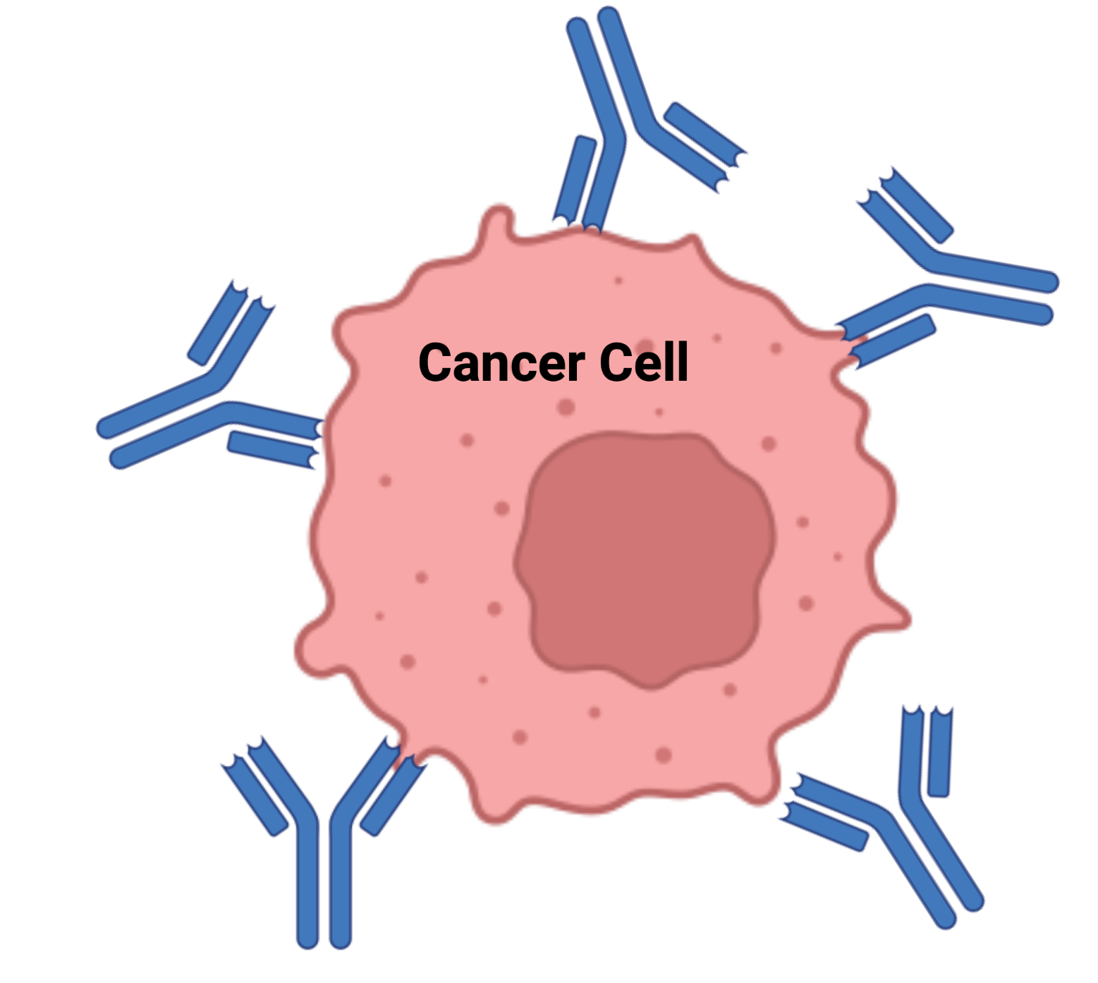
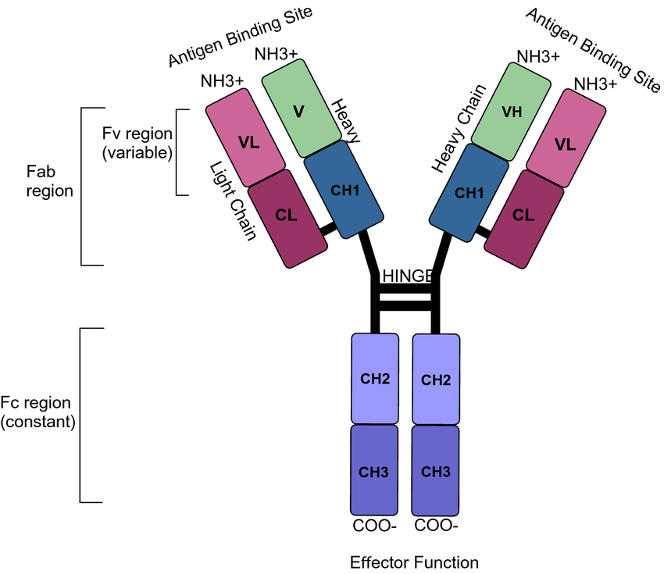
Monoclonal Antibodies (mAbs)
Diseases
Cancer
Alzheimer’s disease
Autoimmune diseases
Types
Bispecifics
NK/T cell engagers
ADCs

Slide 3
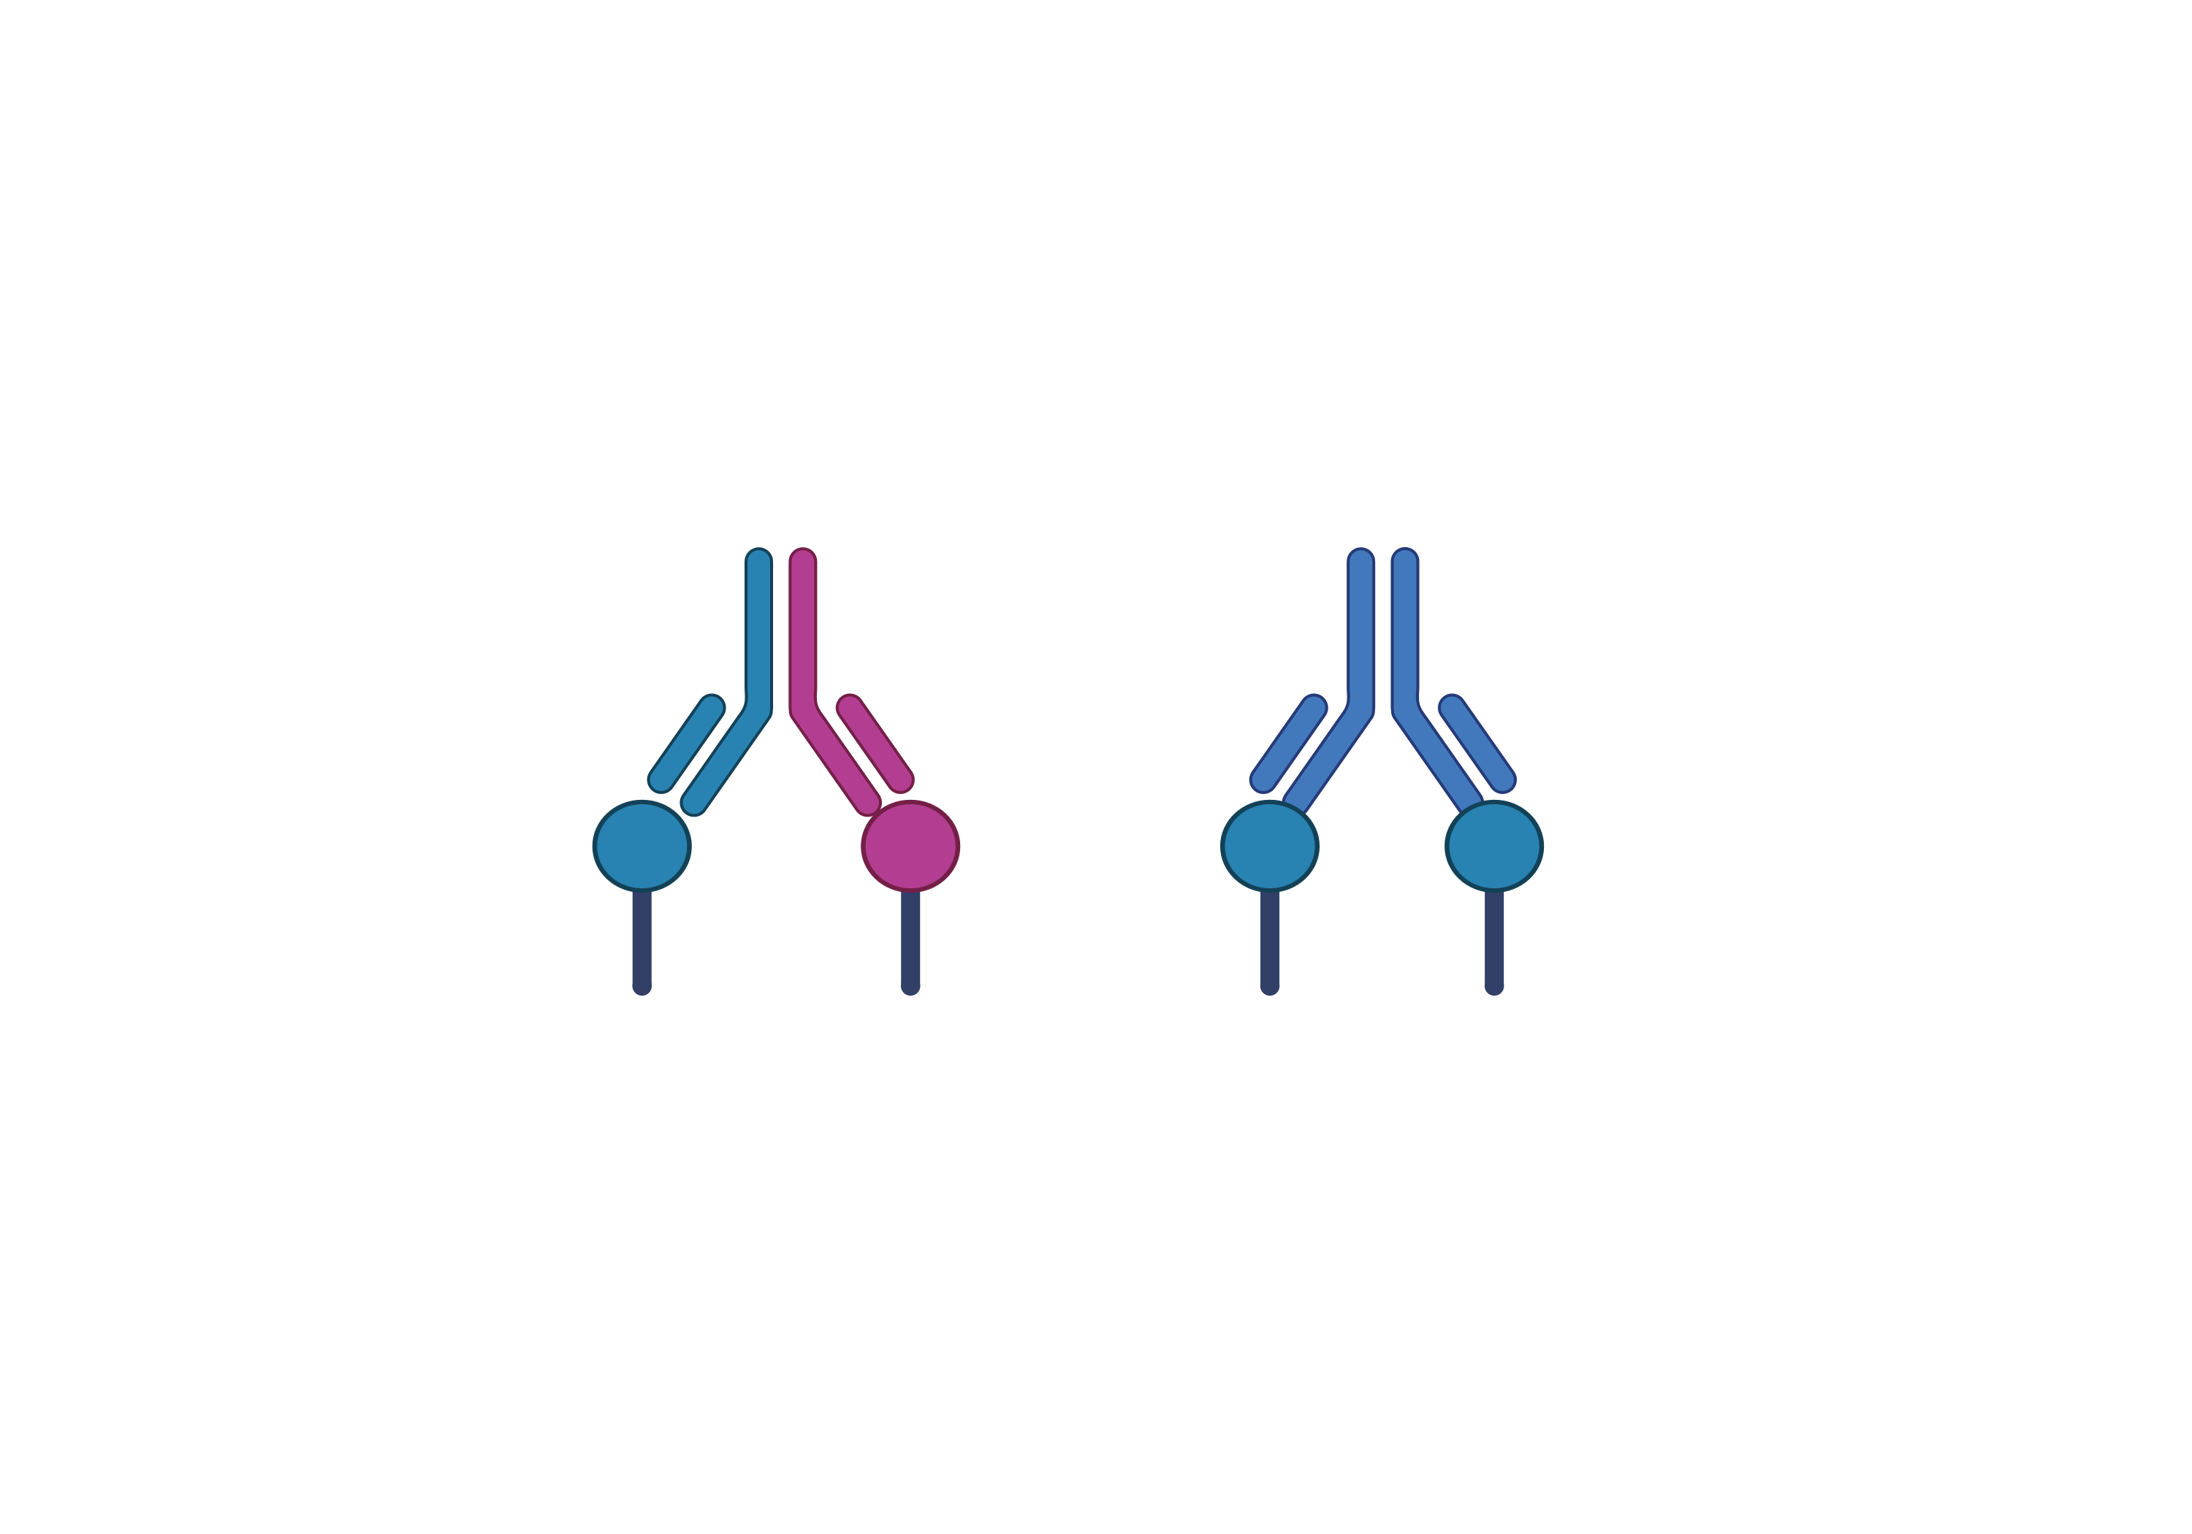

Antibody Types
Bispecific, Bivalent
Monospecific, Bivalent
Monovalent

Slide 4
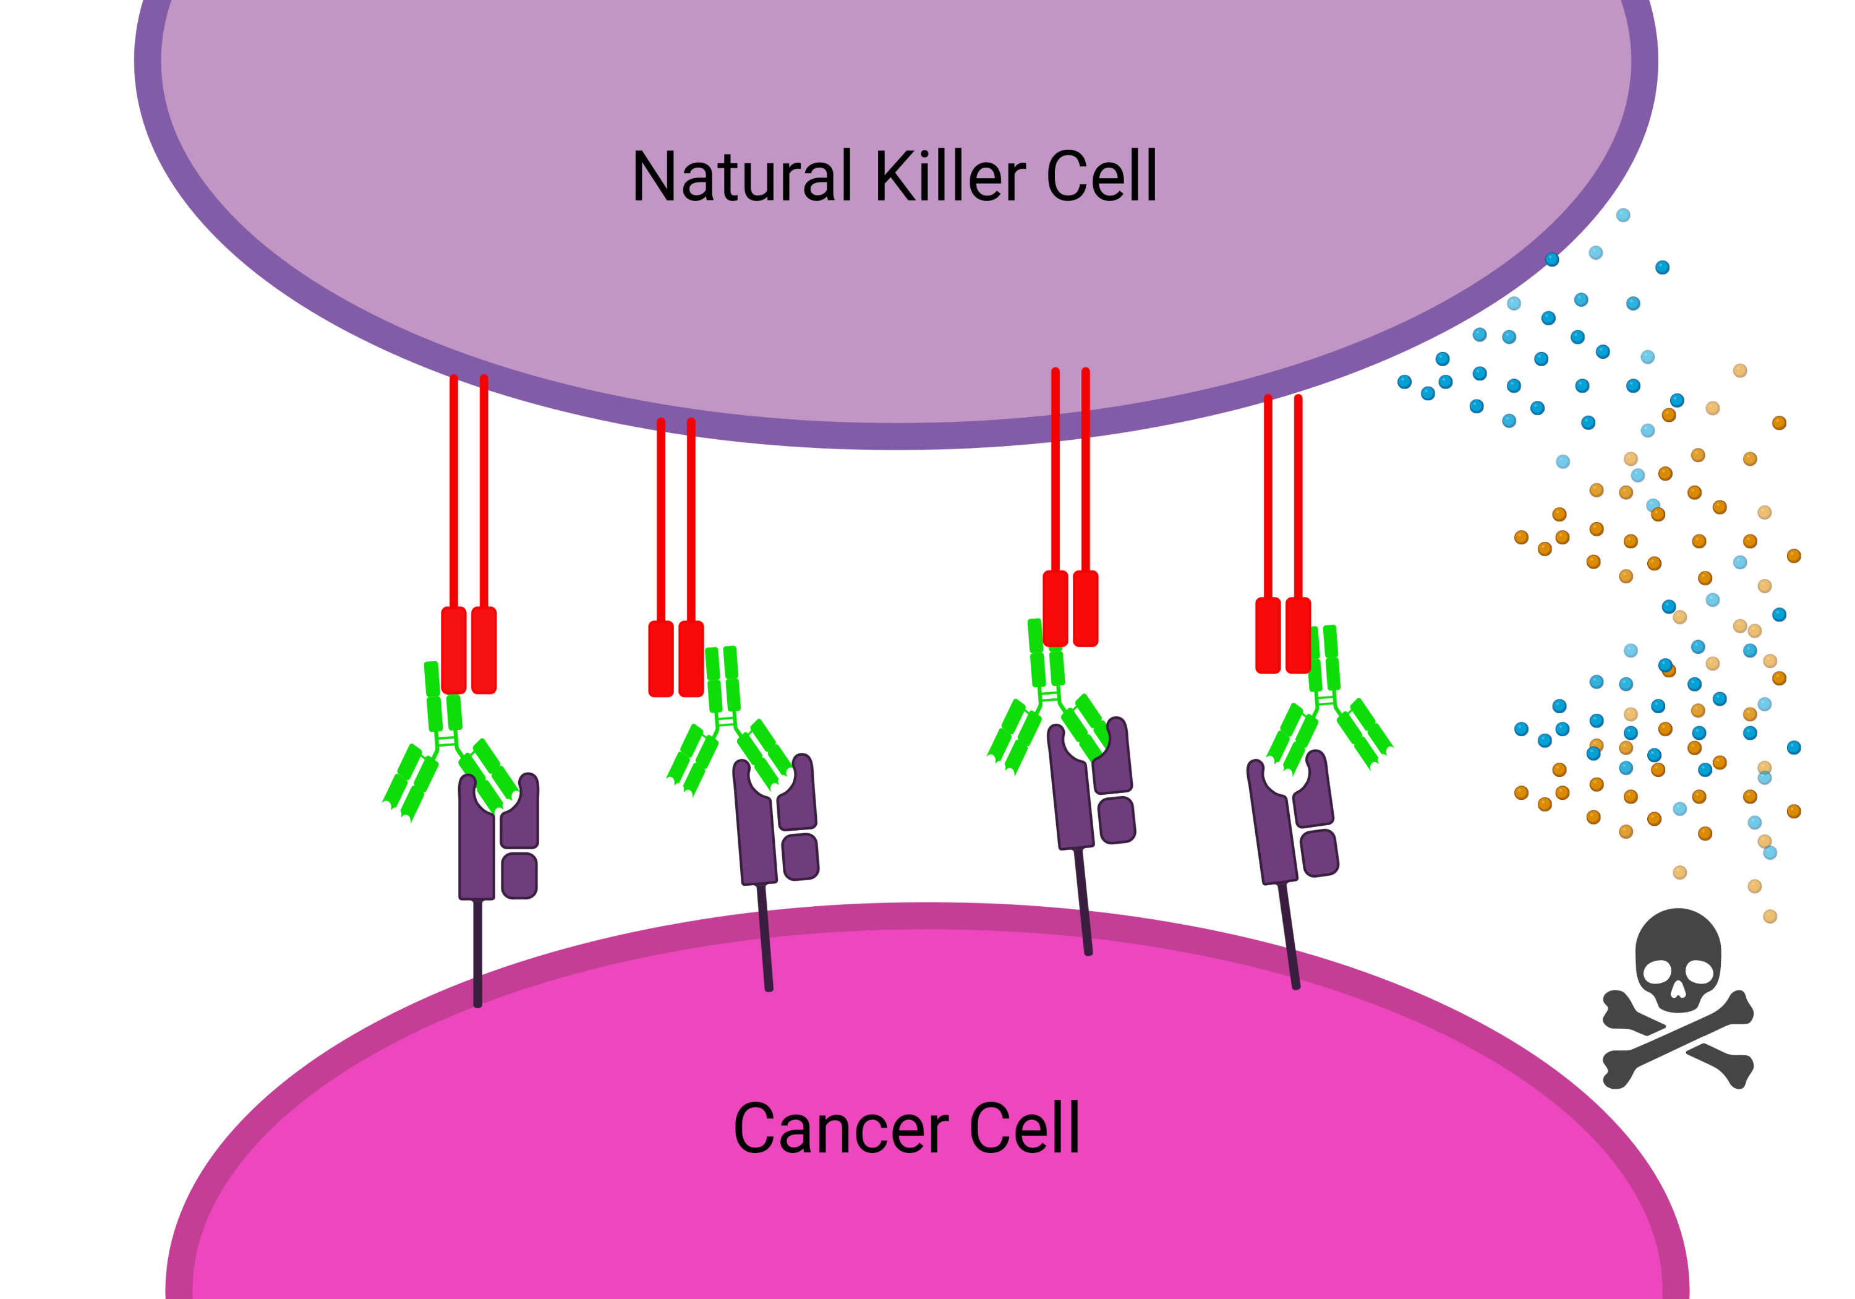
Antibody-Dependent Cellular Cytotoxicity

Slide 5
Linking Antibody Properties to Therapeutic Effect
Response
Log of Drug Concentration
Binding affinity
Antibody format
Receptor expression

Slide 6
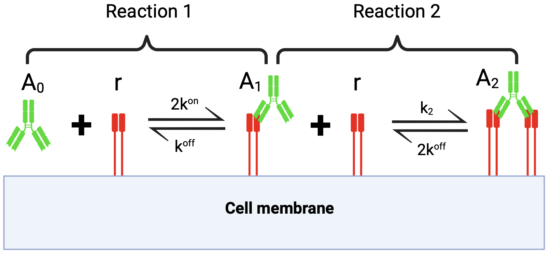
Goal
Response
Log of Drug Concentration

Slide 7
Potency and Efficacy
Efficacy Difference
Drug A
Response
Drug B
Potency Difference
Log of Drug Concentration

Slide 8
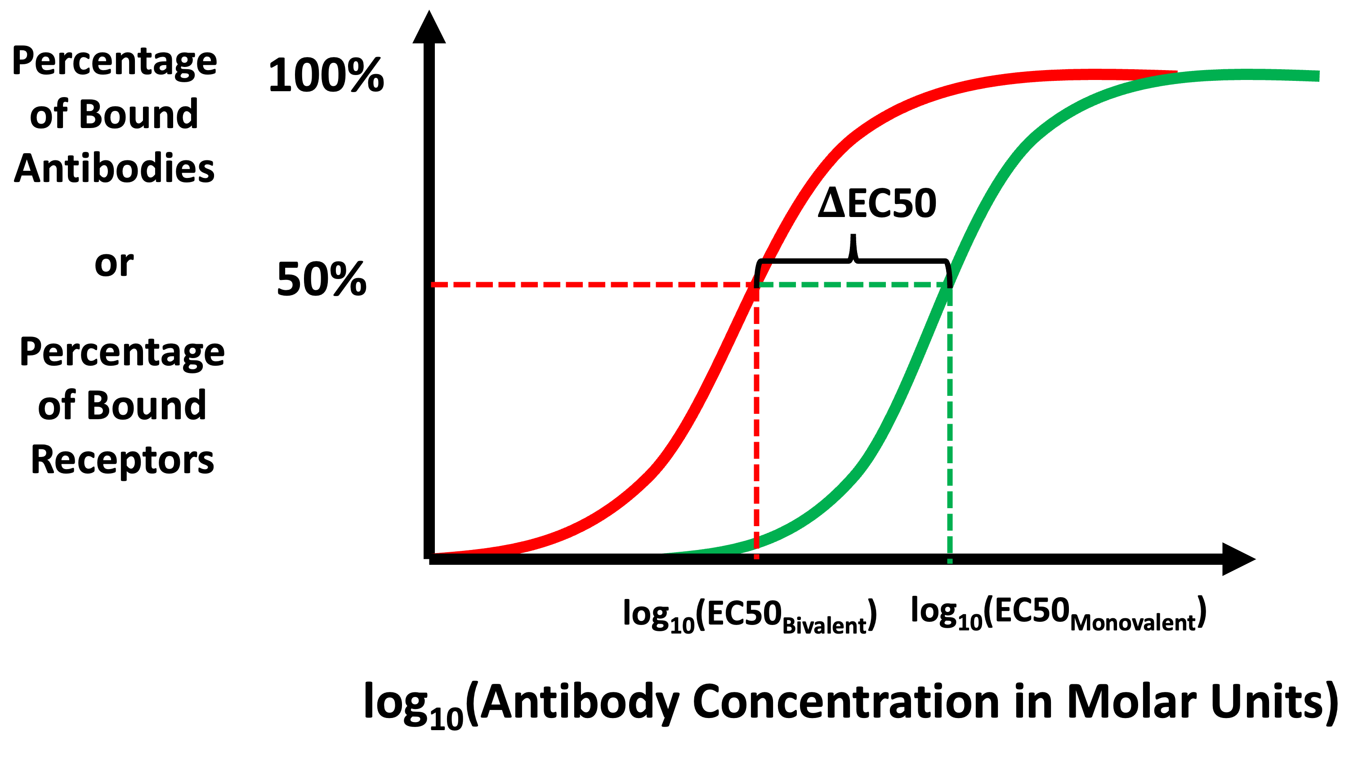
Avidity

Slide 9
Which Format is Best?
VS
Monospecific, Bivalent
Monovalent

Slide 10
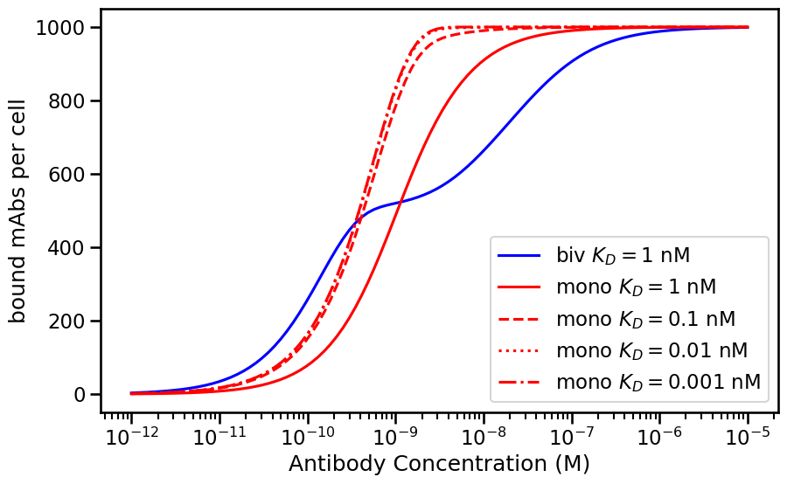
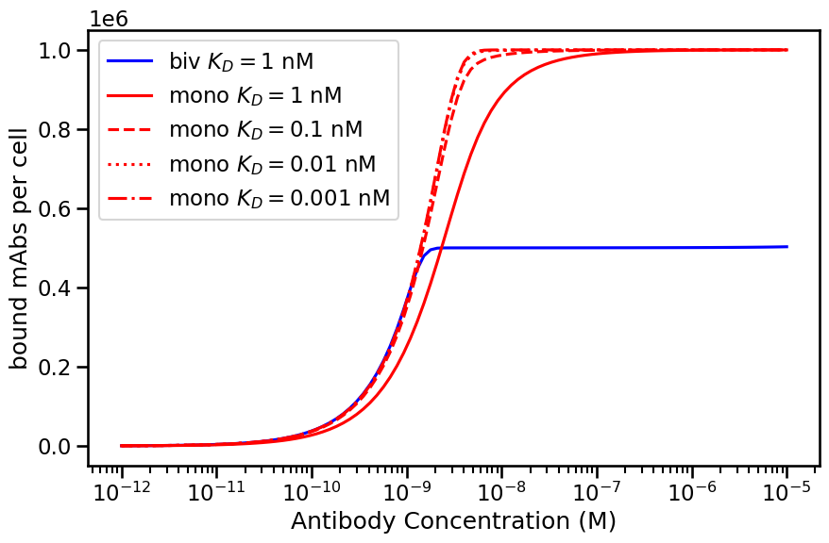
Avidity Barrier for Bivalent Antibodies
Receptor number =10³
Receptor number =10⁶

Slide 11
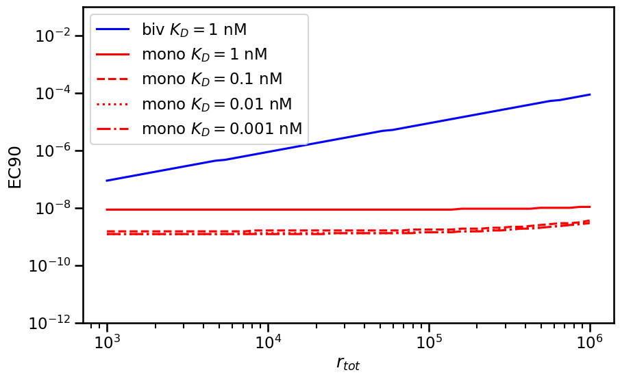
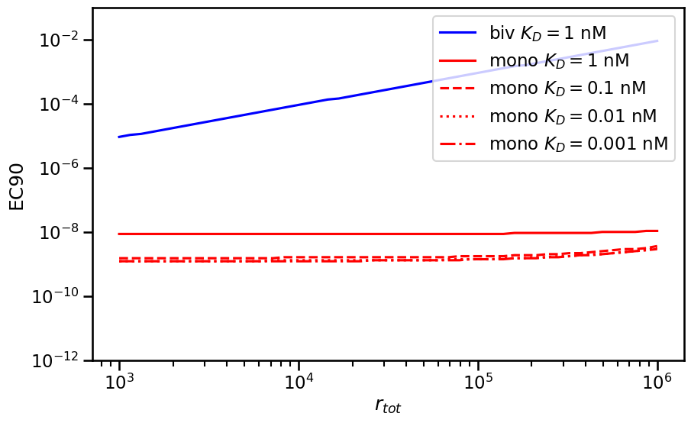
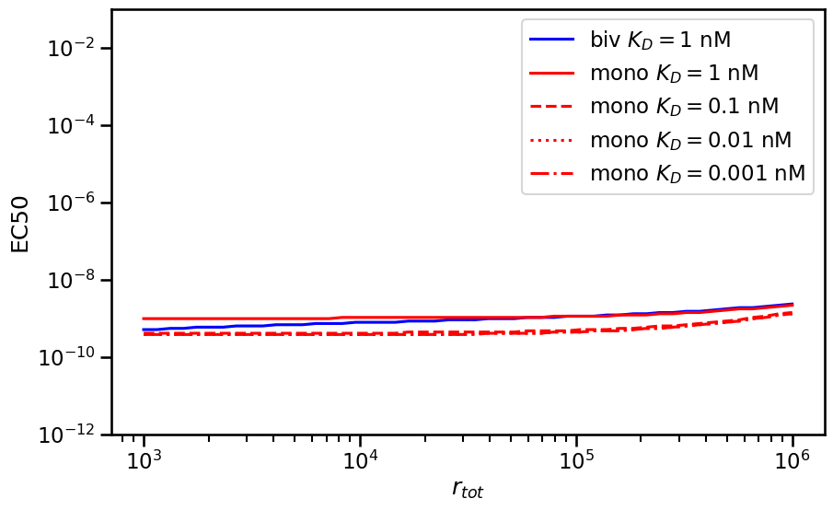
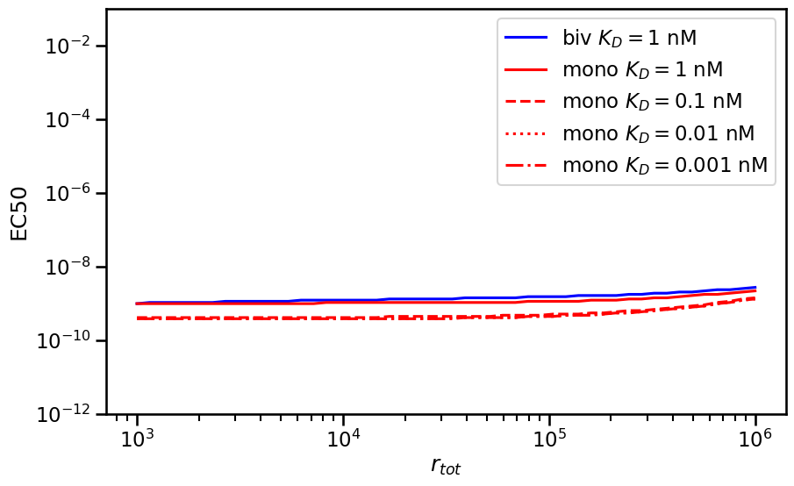
EC50 vs EC90
Weak Avidity
Strong Avidity

Slide 12
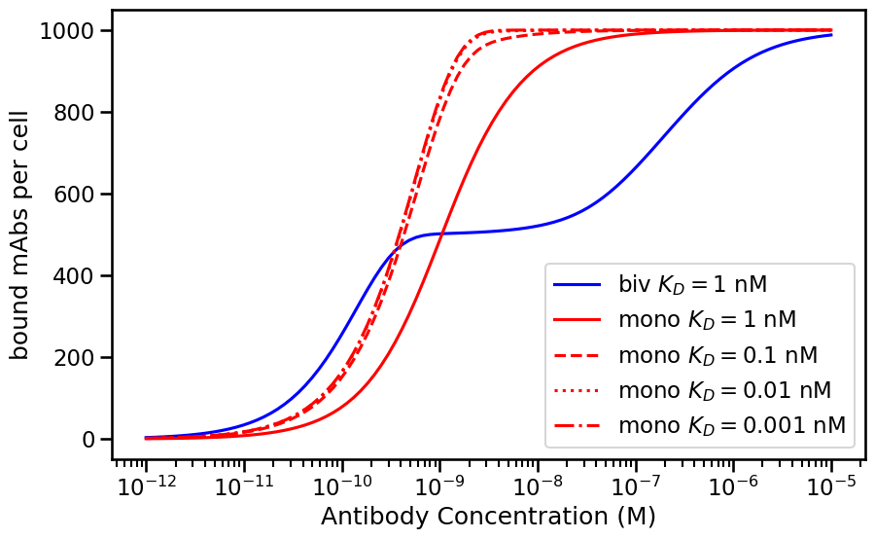
Calculating the Avidity Barrier
Avidity barrier = concentration at which bivalent
Reaches maximum – concentration at which
monovalent reaches maximum
Expectations:
Barrier large for high expression
Barrier increases with strength of avidity (k2)
What is the relationship with affinity?
Avidity Barrier

Slide 13
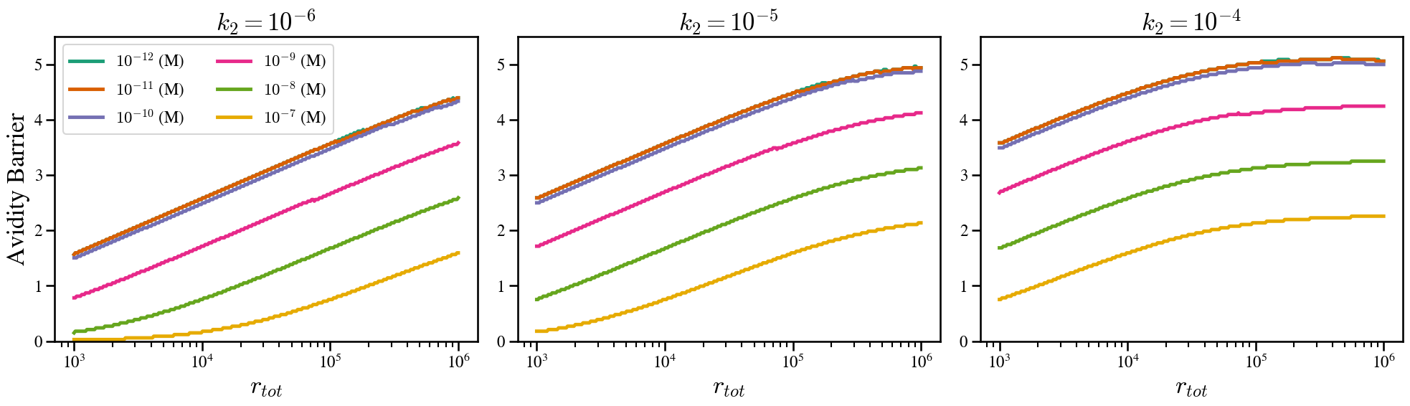
Size of Avidity Barrier Increases with Affinity

Slide 14
Experimental validation
19 cell lines with receptor expression data
4 antibodies with different affinities in both bivalent and monovalent formats
Test antibody binding in vitro

Slide 15
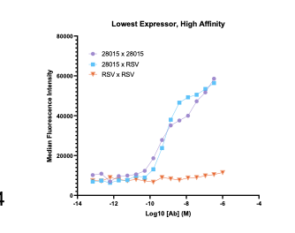
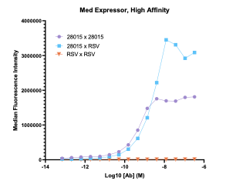
Low receptor number = small avidity barrier
High receptor number= large avidity barrier

Slide 16
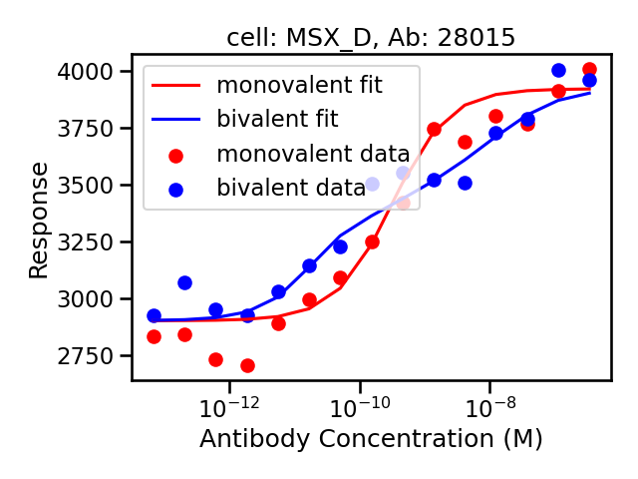
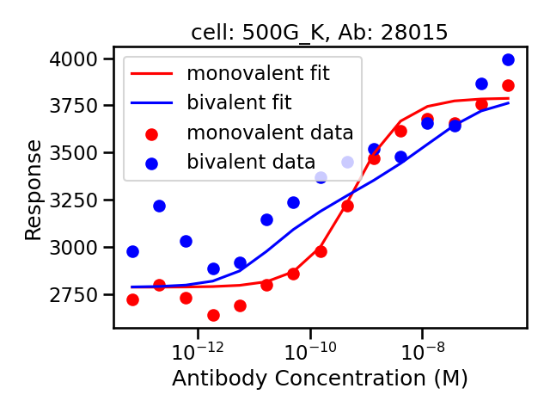
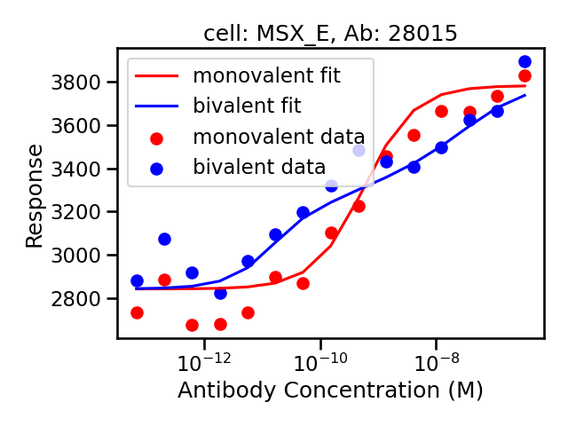

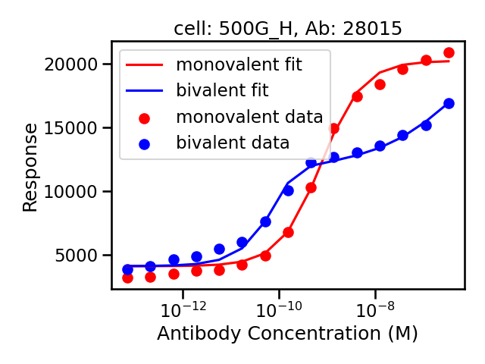
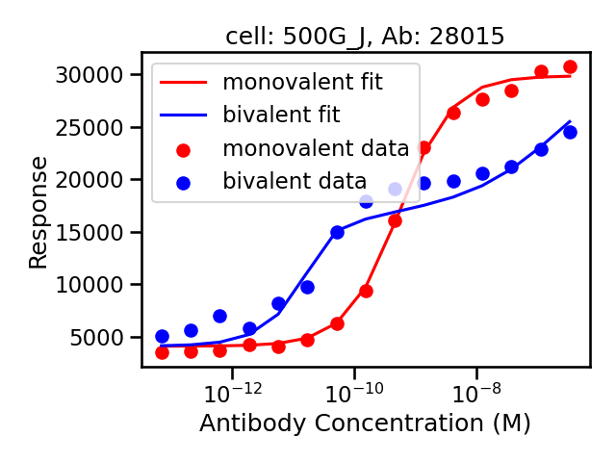
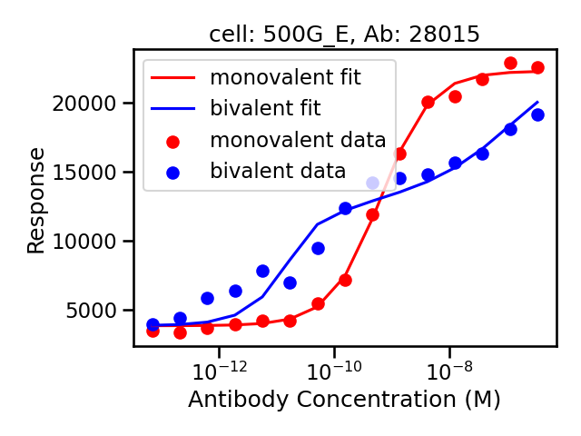
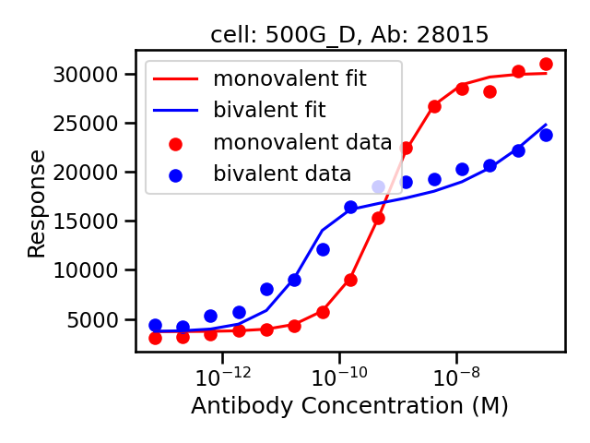
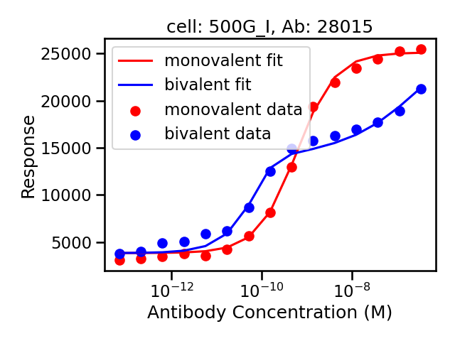
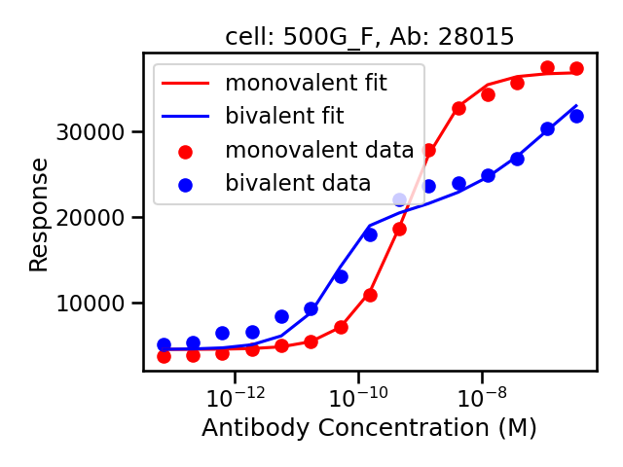
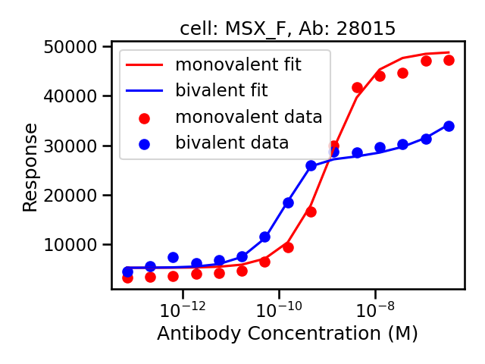
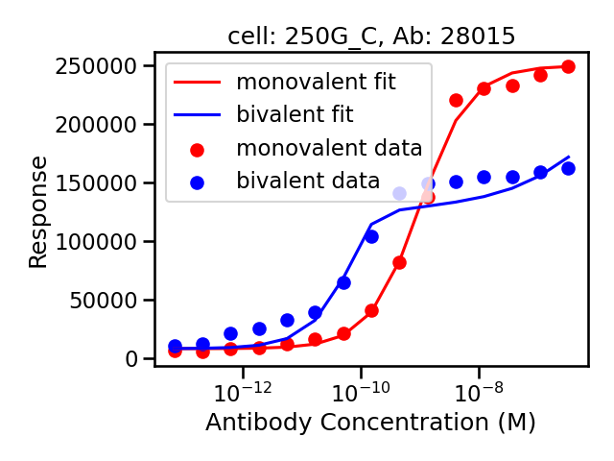
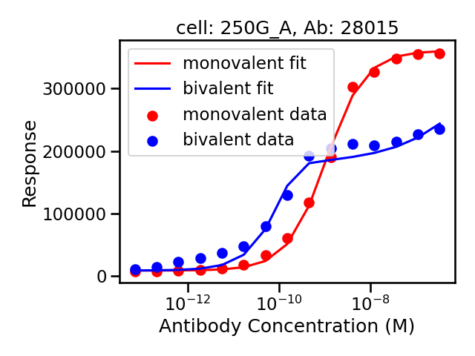
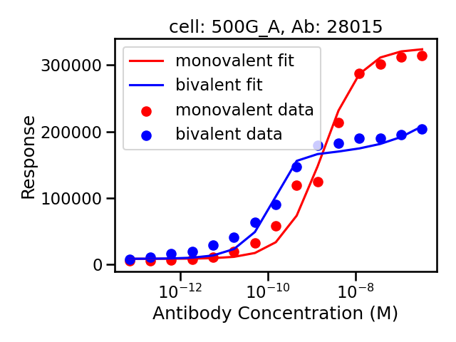
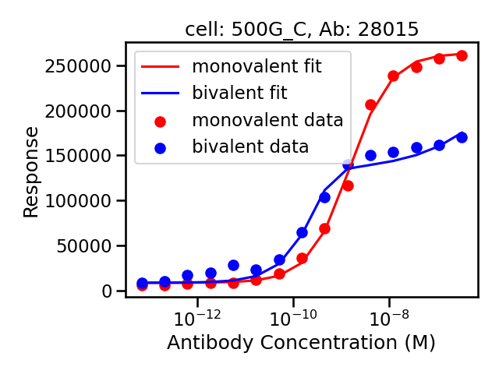
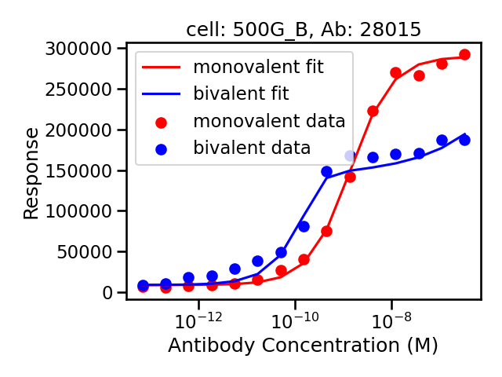
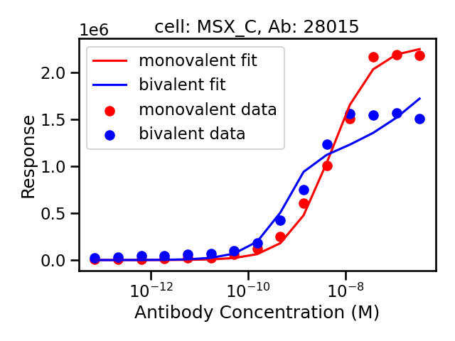

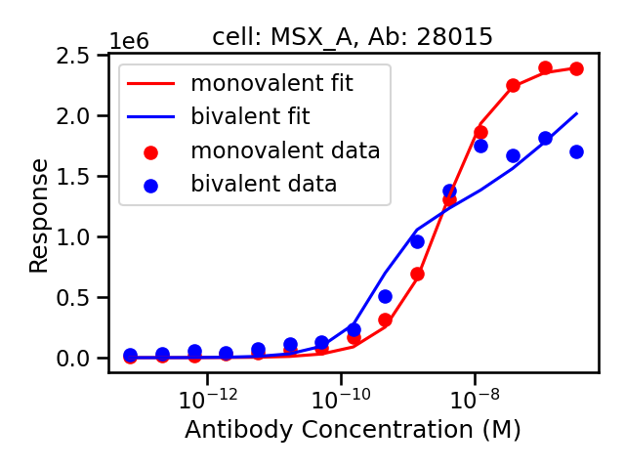

Slide 17



Monovalent Wins
VS

Slide 18
Goal
Response
Log of Drug Concentration

Slide 19
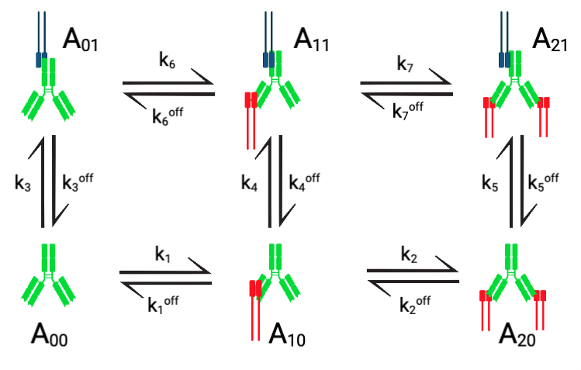
Synapse Model

Slide 20
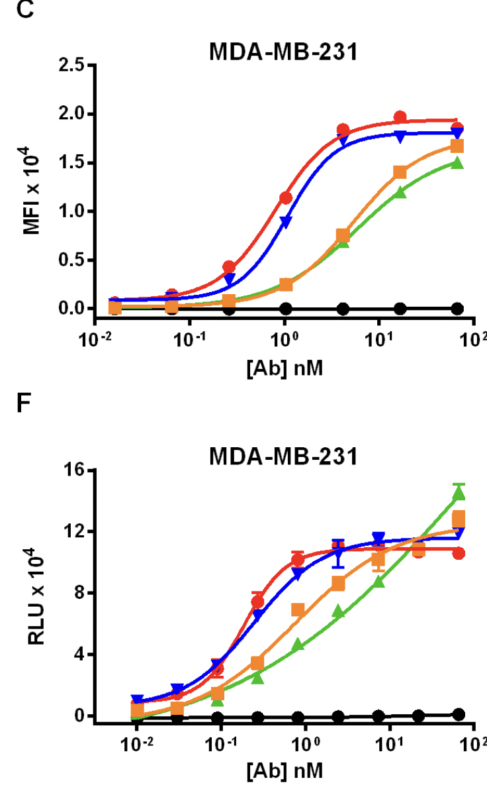
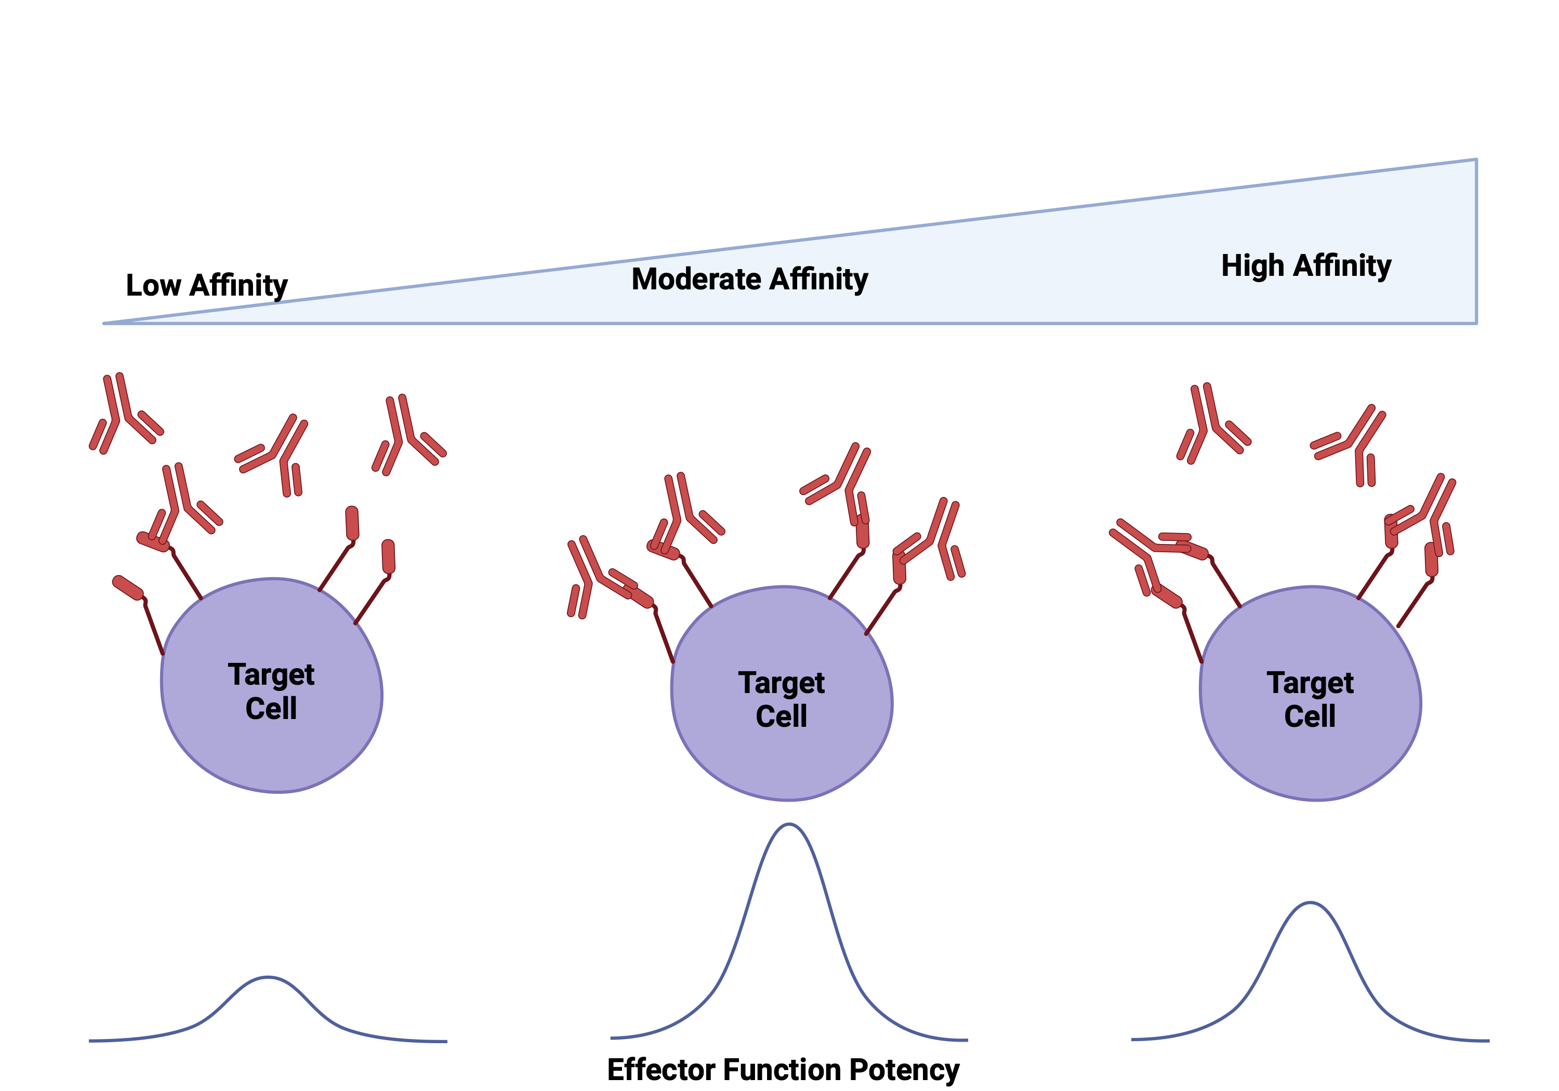
Optimal Affinity for ADCC
https://pubmed.ncbi.nlm.nih.gov/27322177/

Slide 21
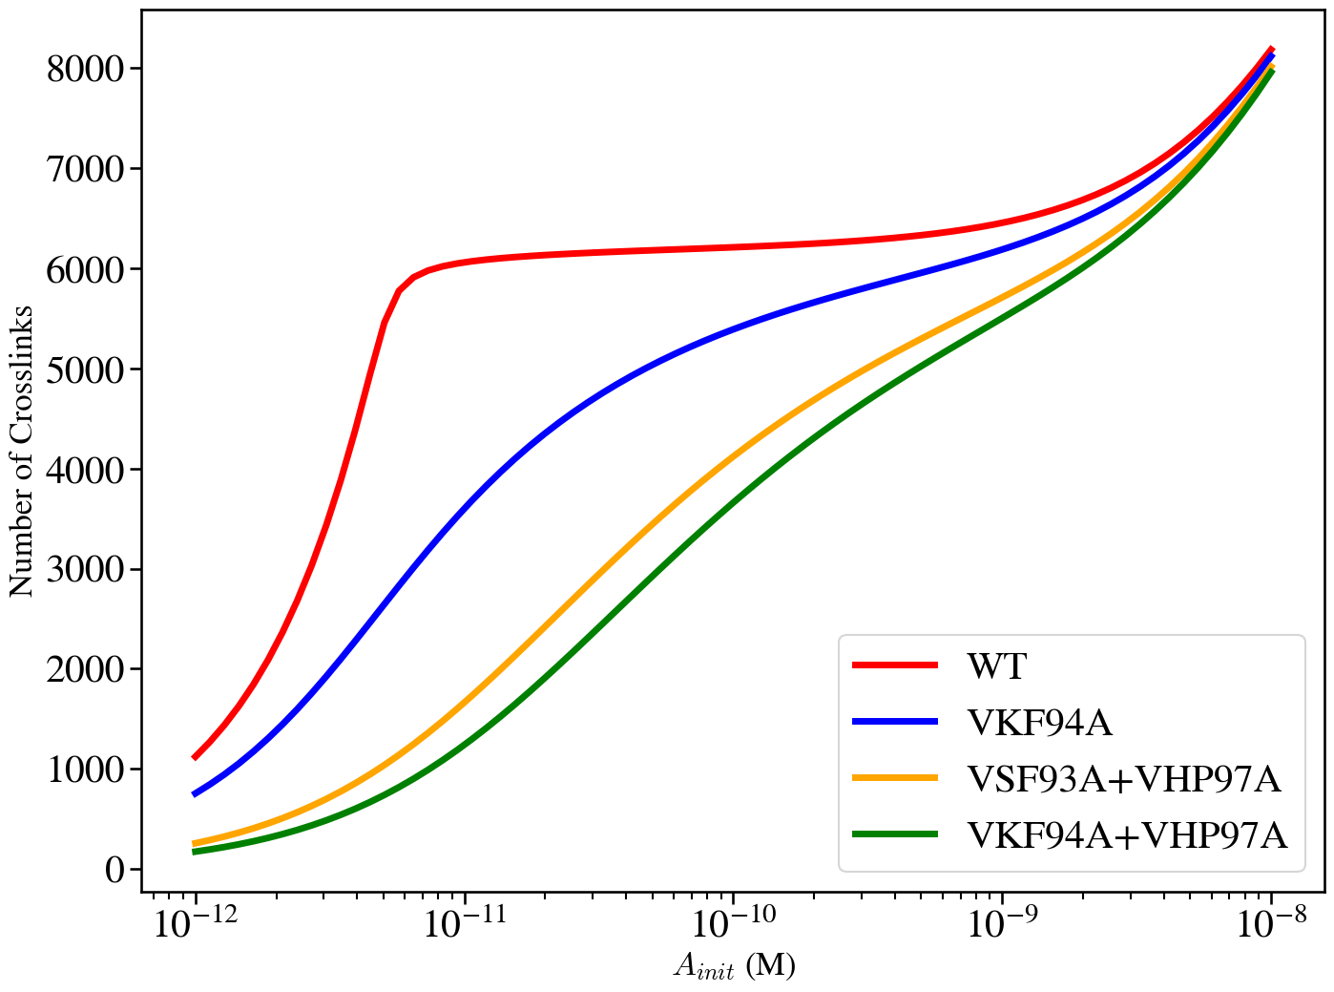
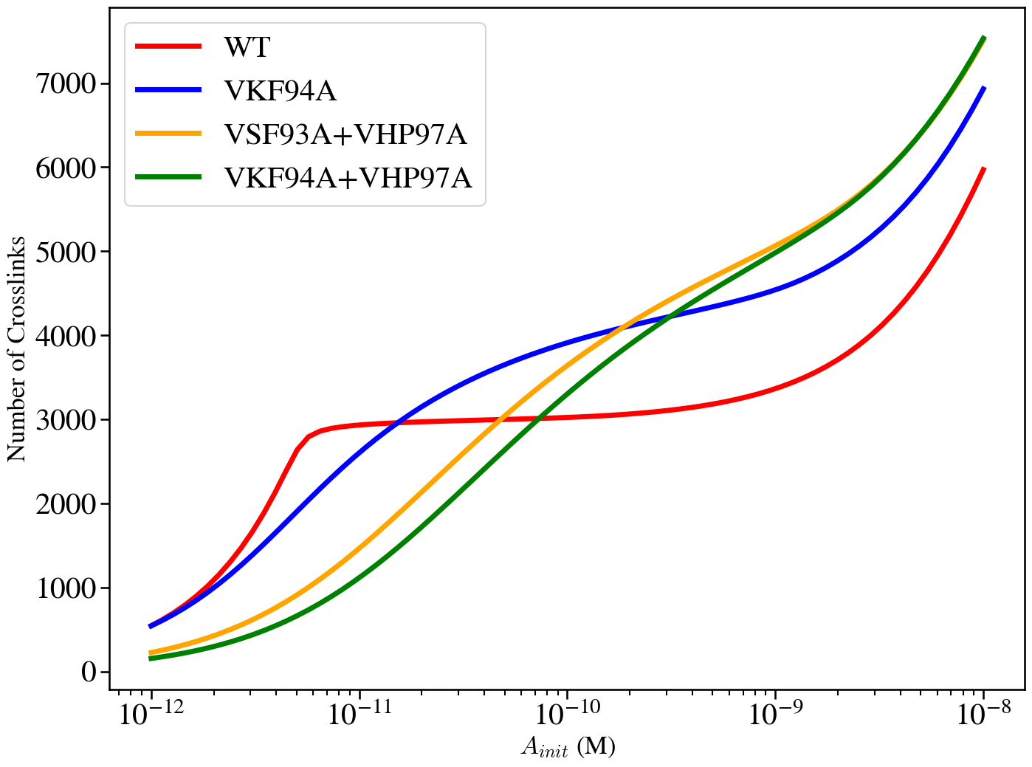
Introducing ‘’Steric Penalty” on Bivalent Antibodies Reproduces Mazor Behavior
k₄ = k₅
k₄ >> k₅
Without Steric Penalty
With Steric Penalty

Slide 22
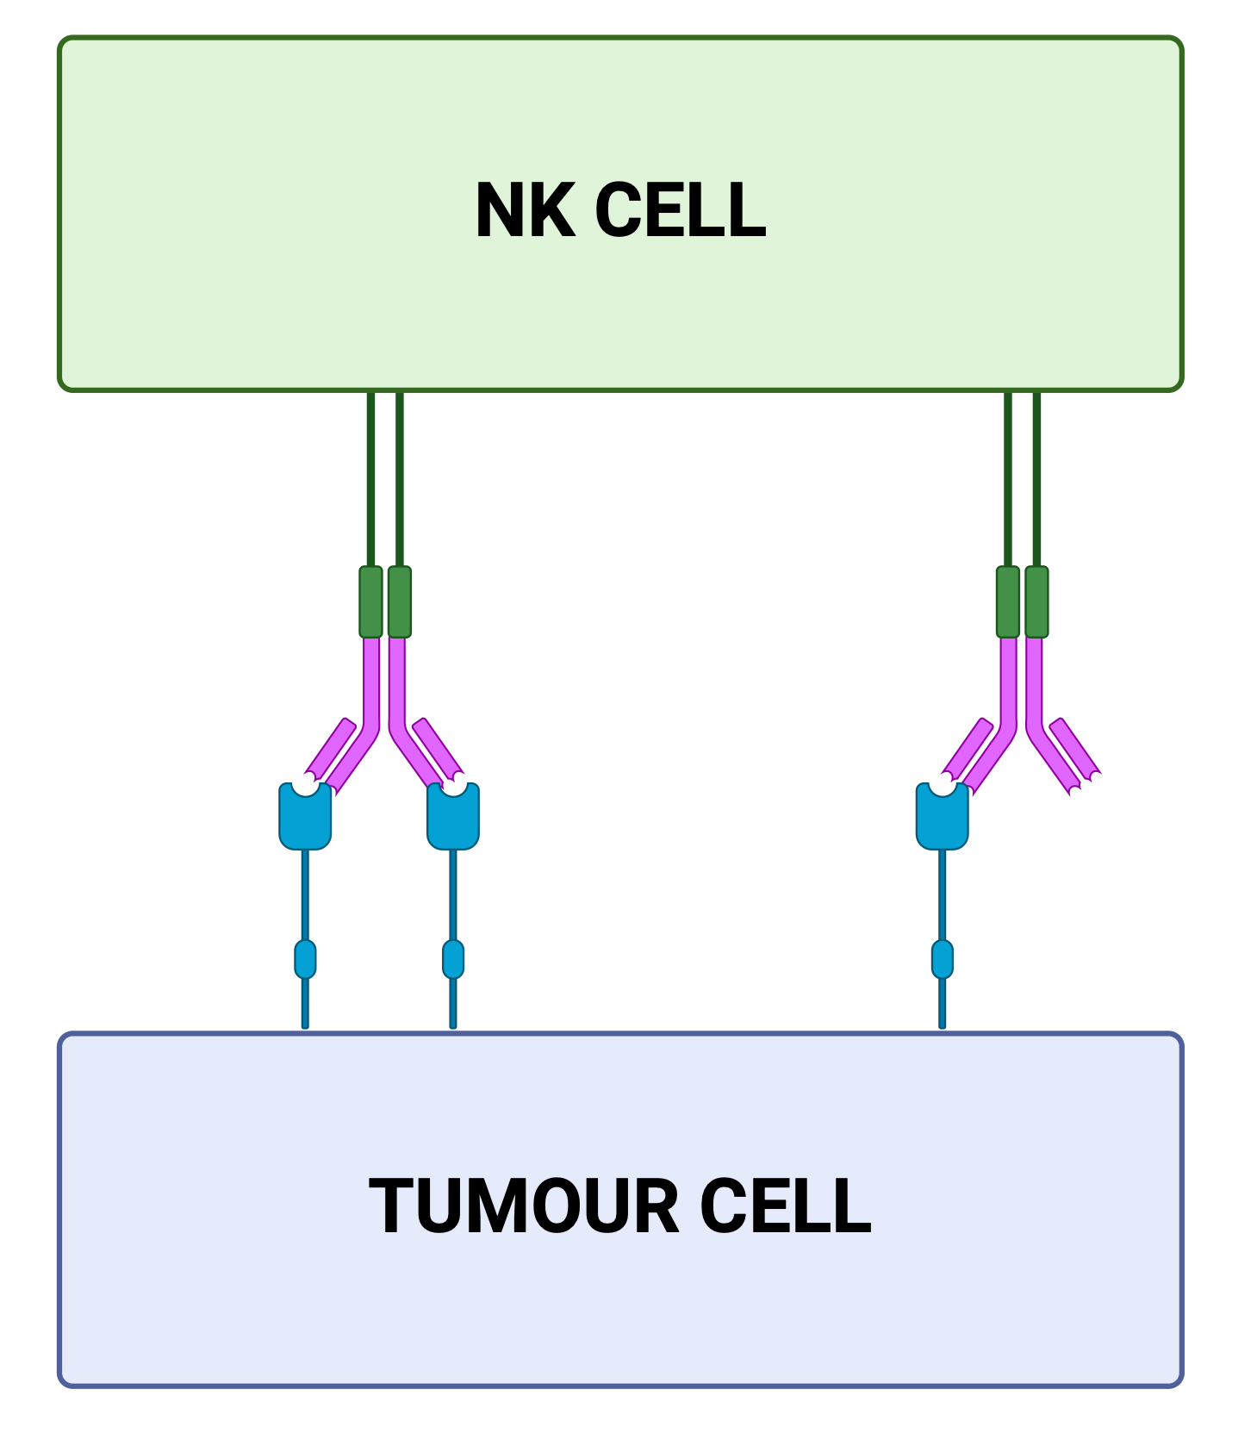
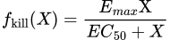
Linking Crosslinks to Response

Slide 23
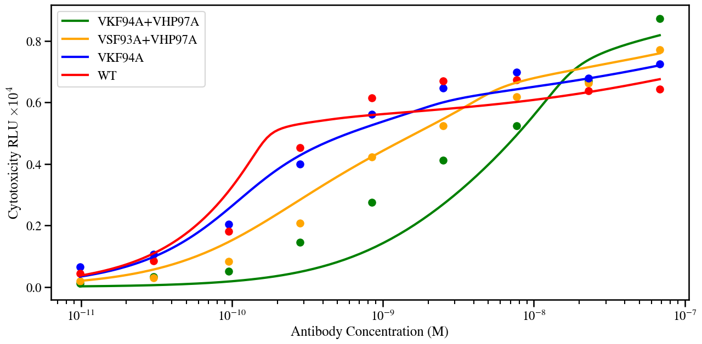
Synapse Model Fits to Mazor Data
k₄ = 10⁻⁵
k₅ = 10⁻⁷

Slide 24
Next steps:

Slide 25
Thank you to:
Oxford:
Helen Byrne
Eamonn Gaffney
Questions?
GSK:
James Yates
James Lodge

